Slide 1


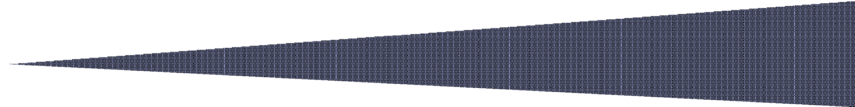


Slide 2
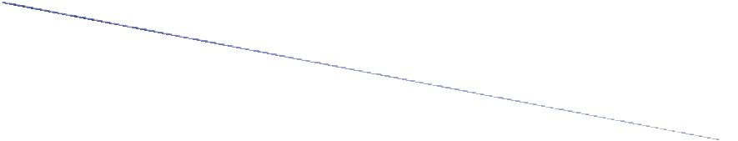


Provide instructions to Register with North Dakota Online Services and Request Access to
C O S M O S
Provide instructions to Apply and Submit grant applications and contracts through
Instructions to Apply for Reimbursement Requests
Instructions to manage fiscal and reporting requirements
The Work Queue section is your agency’s current task and grant information center

Slide 3

To request access to the COSMOS Grant Management System, open the hyperlink below.
https://apps.nd.gov/docr/cosmos/menu
**A North Dakota Login account is required to access COSMOS.**
If you have a North Dakota Login, go to Page 11.
If not, continue with next slides.
It is recommended to save this hyperlink
to your desktop by creating a shortcut for easy access

Slide 4
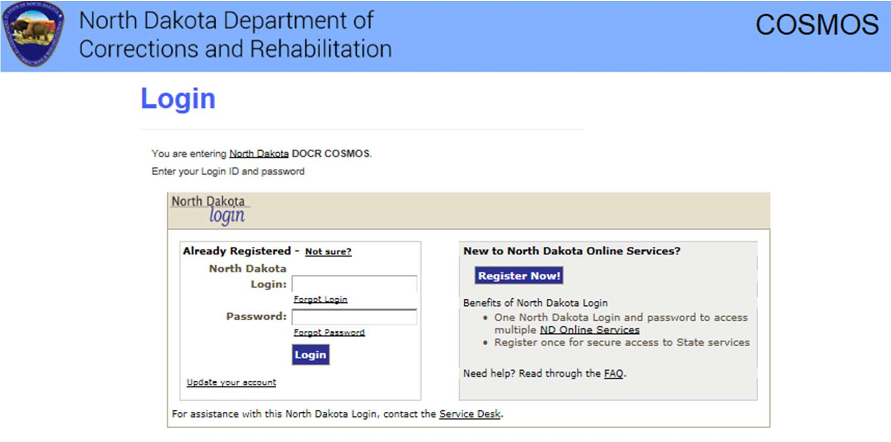
Click on Already Registered - Not Sure?
UNSURE IF YOU HAVE A NORTH DAKOTA LOGIN ACCOUNT?

Slide 5
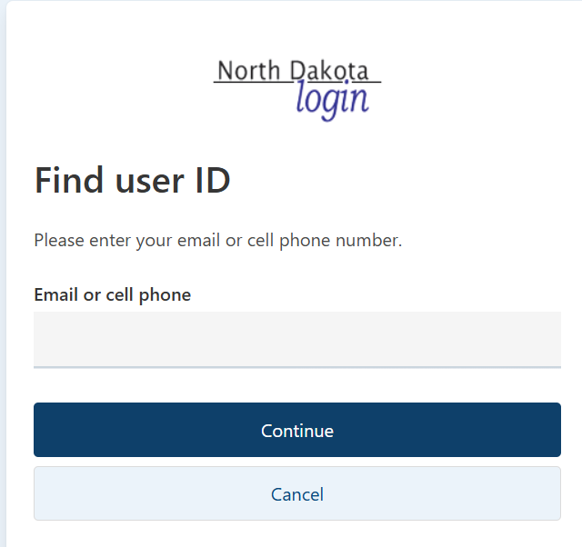


Enter your email or cell phone number for verification of a North Dakota Login account
North Dakota State Government
login
reCAPTCHA
·T

Slide 6
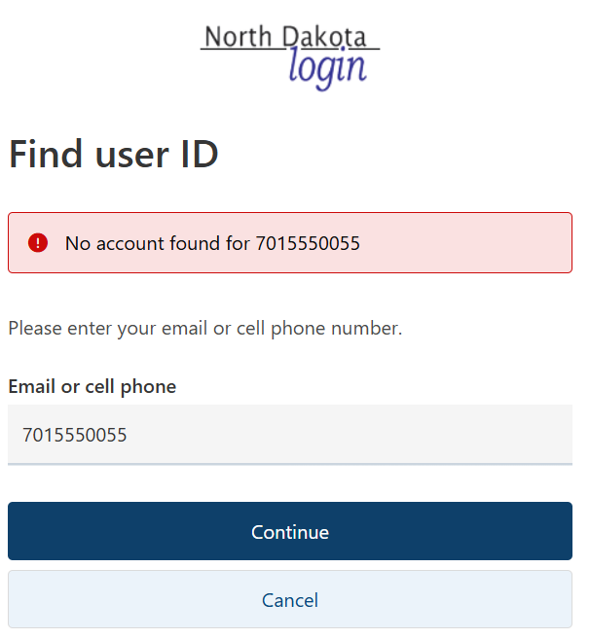
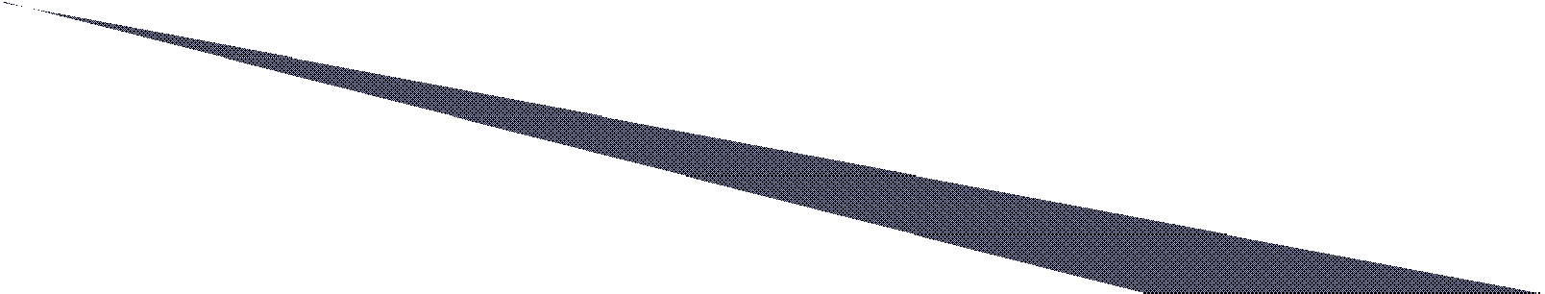
If you receive an error message No account found, you do not have a North Dakota Login account.

Slide 7
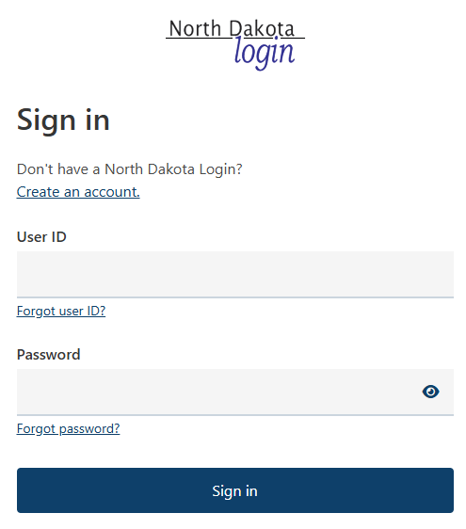

IF YOU DO NOT HAVE A NORTH DAKOTA Login ACCOUNT:
To set up a new North Dakota Login account, click on the
“Create an account” link
Follow directions on slides 8 through 10 of this PowerPoint

Slide 8
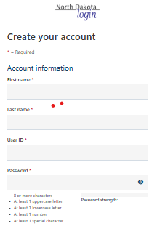

COMPLETE AND SUBMIT THE ACCOUNT INFORMATION
TO OBTAIN YOUR NORTH DAKOTA LOGIN ACCOUNT

Slide 9
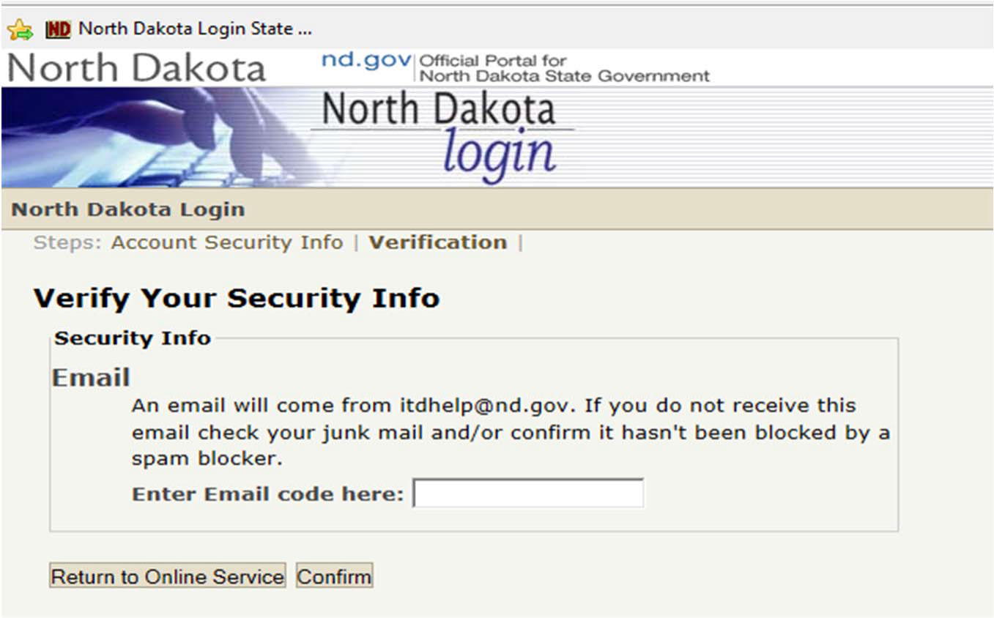

VERIFY YOUR SECURITY INFO
An email from itdhelp@nd.gov with an Activate Account Code will arrive to the email entered to set up the account.
Enter the Activate Account Code as indicated and Confirm

Slide 10


REQUEST COSMOS SYSTEM ACCESS
Login with your North Dakota Login ID and Password on the left side of the screen to Request COSMOS System access.

Slide 11
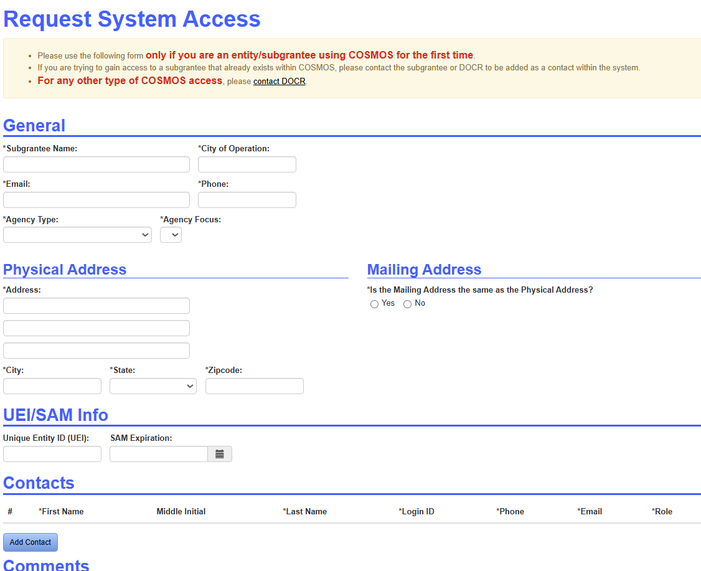

REQUEST COSMOS SYSTEM ACCESS (CONT.)
Complete and submit the Request System Access Page
VOCA and RSAT subgrantees are required to provide a current UEI/SAM Info and Expiration Date. Other subgrantees, leave these fields blank.
Contacts: Add Point of Contact, Fiscal Point of Contact, and Performance Reporting Point of Contacts for your agency. These may be assigned to the same individual.

Slide 12

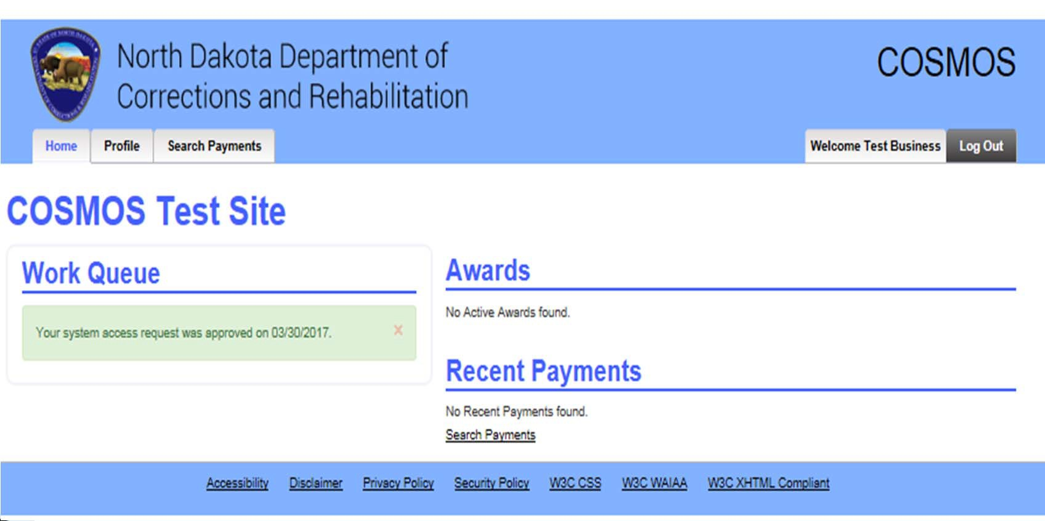

The Home Tab contains the Work Queue section, which is your agency’s task and information center for receiving notices similar to the example below

Slide 13
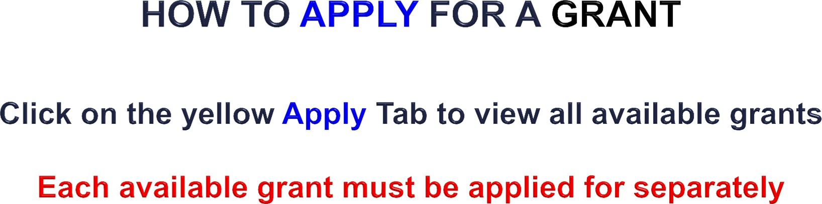
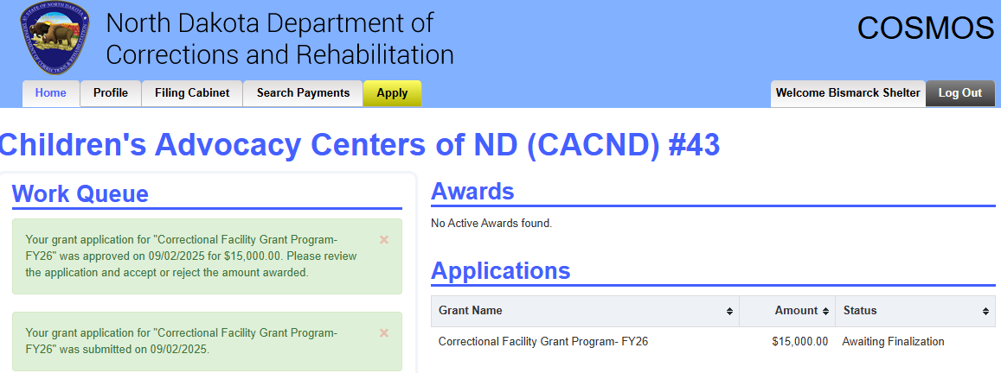


Slide 14

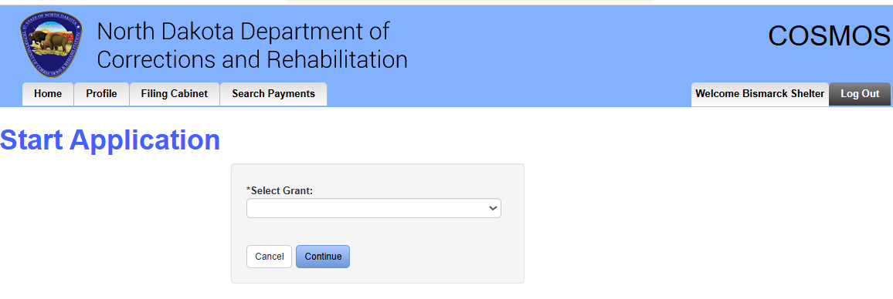

Click on the arrow located in the Select Grant section to apply for a grant. Click on the grant your agency intends to apply for to start the application process. Each available grant must be applied for separately
Applications “in progress” may be saved and completed at a later date “In progress” applications are located on the HOME tab under the Awards section

Slide 15
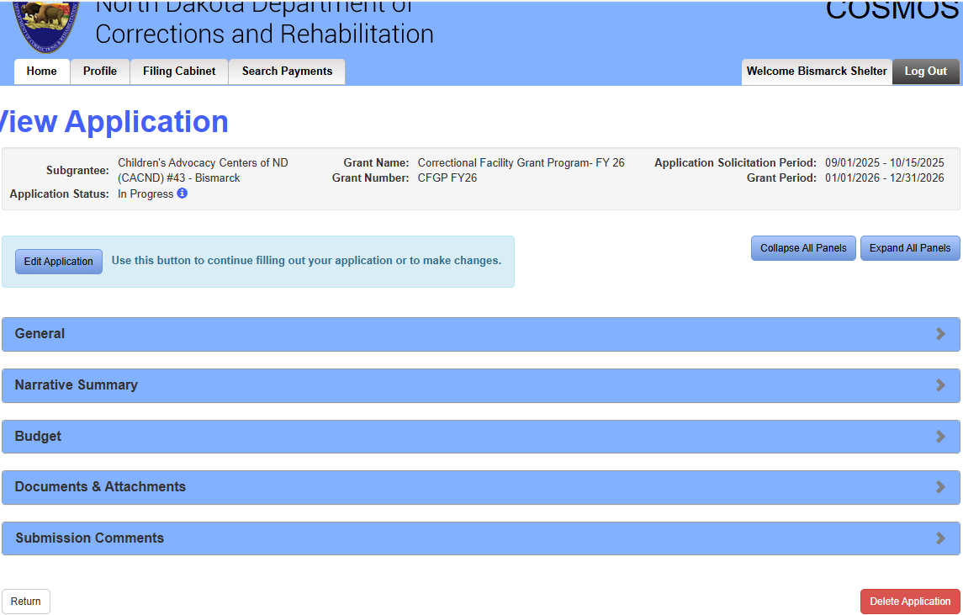
VIEW GRANT APPLICATION PANELS
Click on Expand All Panels button to view and complete the requested application information

Slide 16
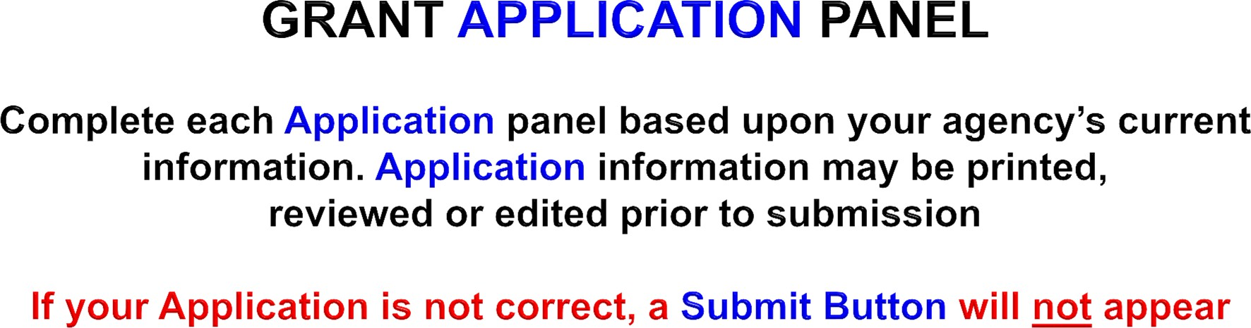
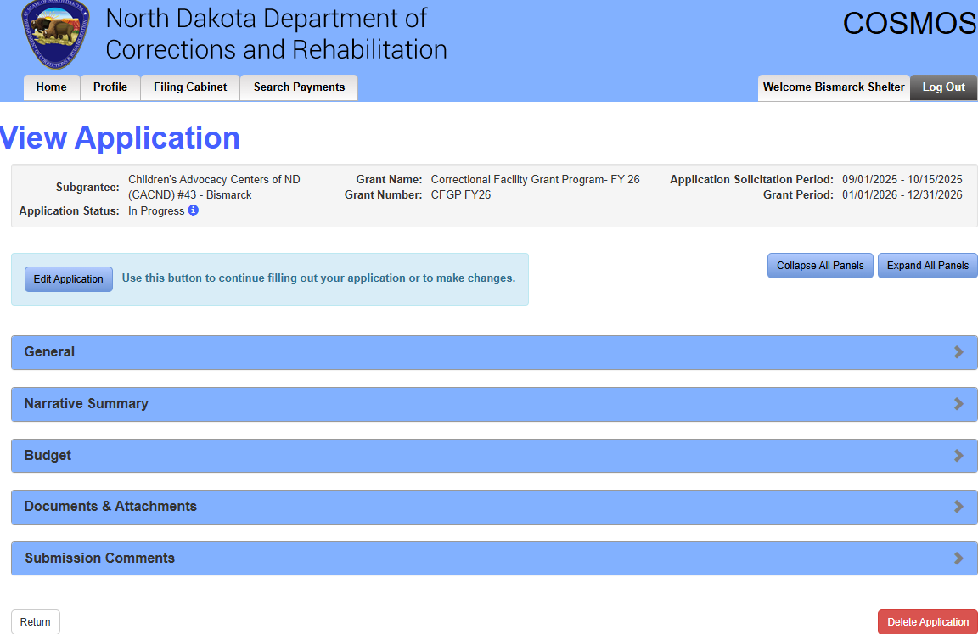

General Panel
Narrative Summary Panel
Budget Panel
Documents & Attachments Panel
Submission Comments Panel
NOTE: Some grant applications may have additional panels to complete.

Slide 17
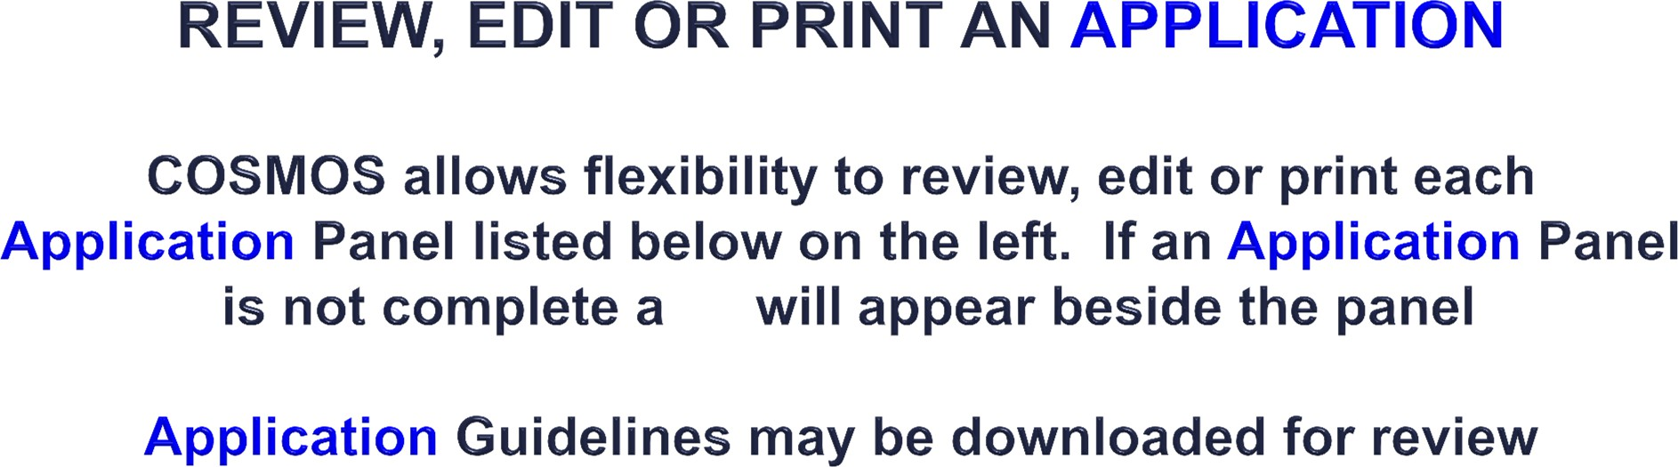
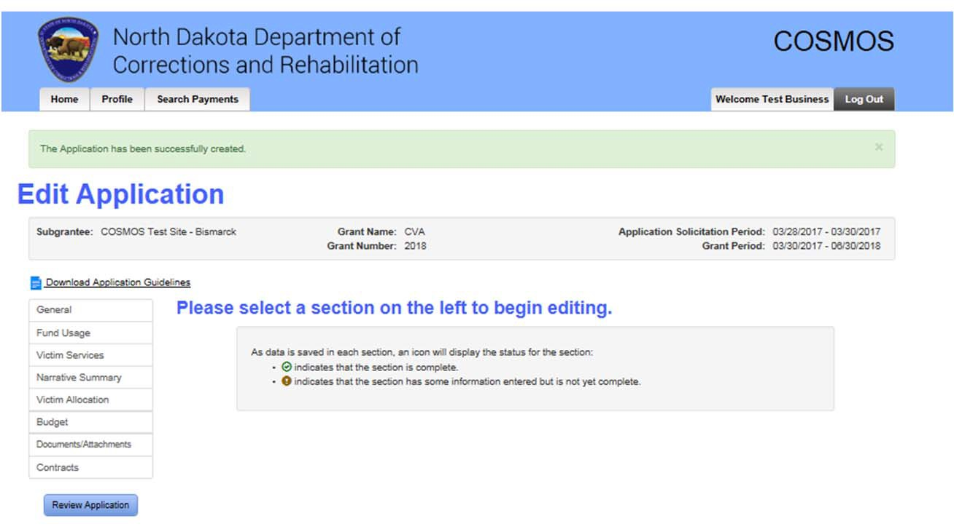

!

Slide 18
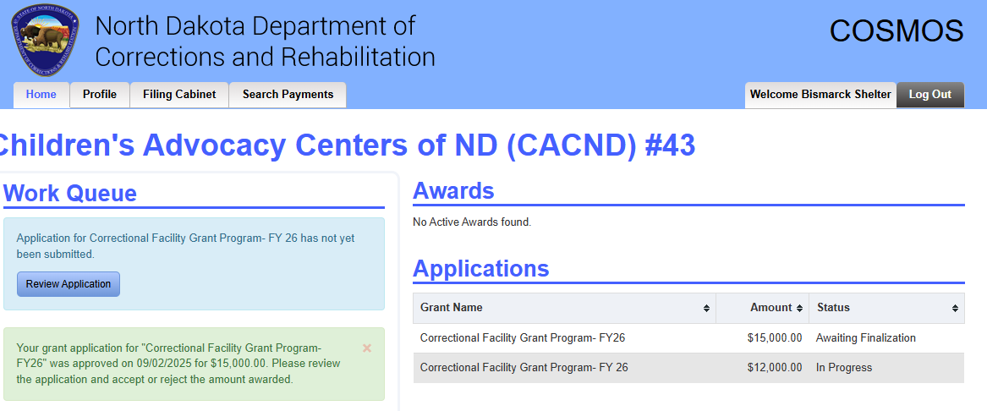

APPLICATION IN PROGRESS
“In Progress” applications may be saved and completed at a later date. Click on the Home tab, under the Applications section click on the appropriate grant for access OR under Work Queue click on “Review Application”

Slide 19
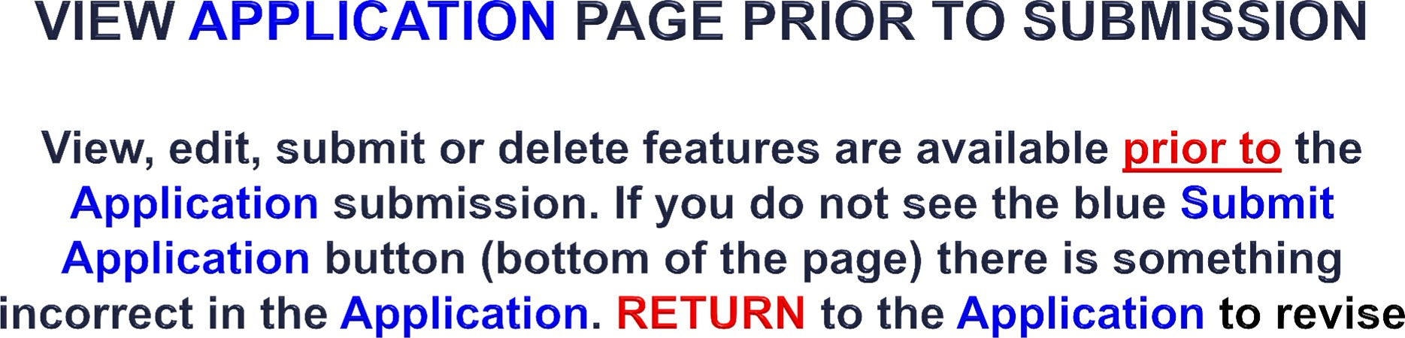
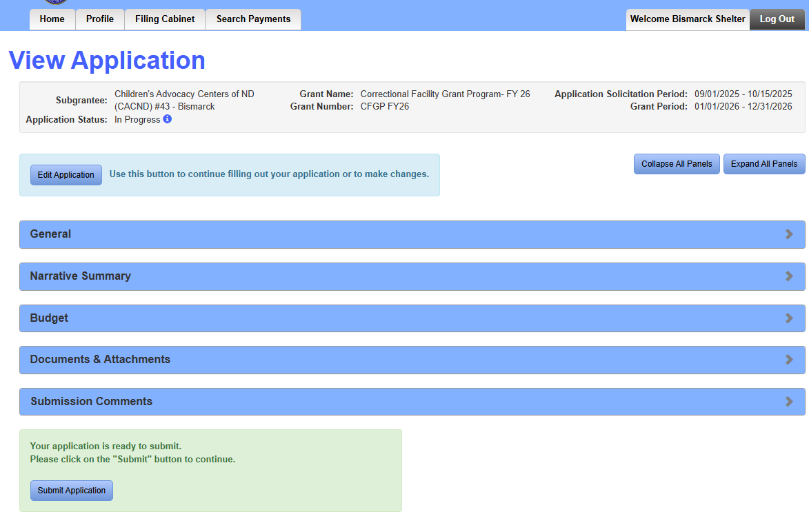


Slide 20

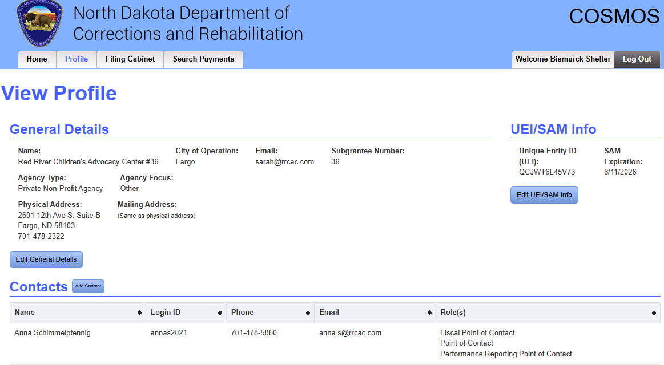

Your agency may view or edit information on the Profile tab at any time during the grant cycle

Slide 21
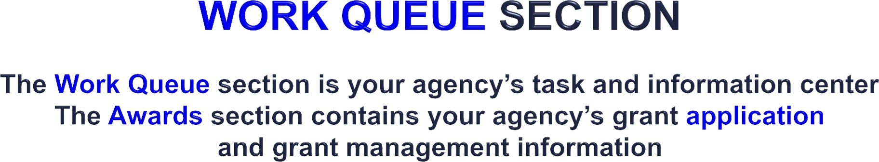
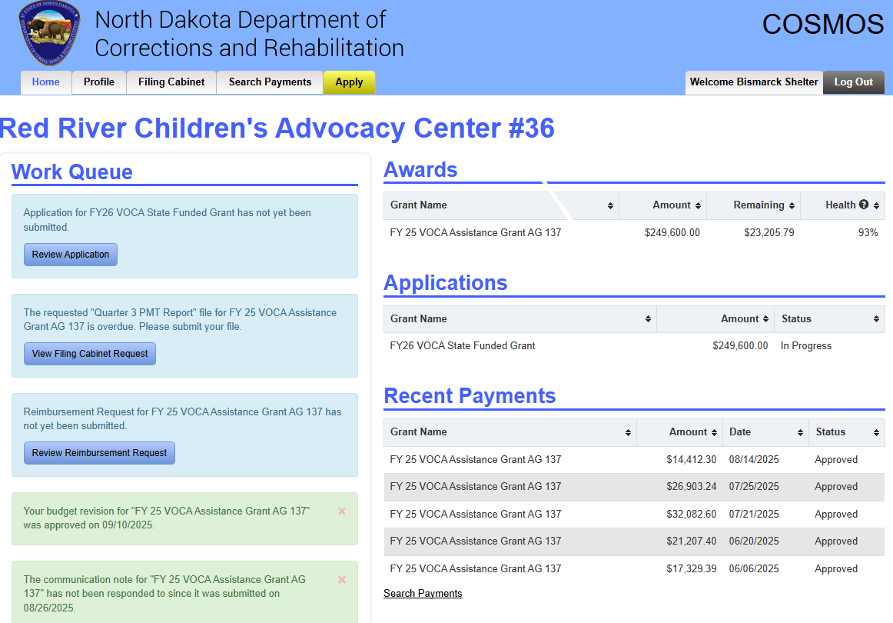


Slide 22


HOME tab
Work Queue Section - Task and information center
Awards Section - All current grant information; reimbursement requests; general grant information
View Awards by Grant Name (select grant)
General
Budget
Reimbursements
Match Amounts (if applicable)
Budget Revisions
Filing Cabinet
Closeout Report
Applications Section
Review submitted, accepted, and In Progress Applications
Recent Payments Section
Closed Awards Section

Slide 23

COSMOS GRANT MANAGEMENT
TABS CONTINUED
PROFILE tab
View or Edit General Details; Contacts; Physical Address; Mailing Address
FILING CABINET tab
Filter Filing Cabinet Requests by Grant Award, Title, Submitted Date Start, Submitted Date End; Current Status – Unsubmitted, Submitted, Returned, Approved.
SEARCH PAYMENTS tab
Filter and search by: State Date; End Date; Grant Award; Current Status – Approved, Reviewed, In Progress, Deleted, Submitted, Denied, Repayment

